Slide 1


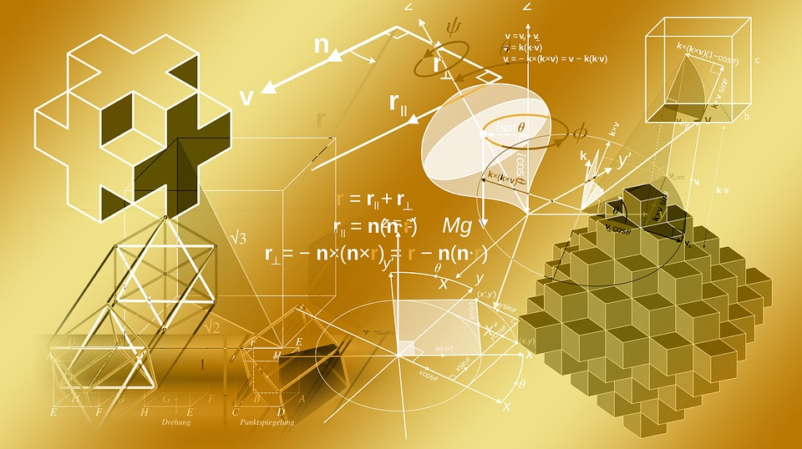


Graph Theory: Applications and Examples
By:- Ujjwal Patle
B(58)

Slide 2

Introduction to Graph Theory Graph theory is a branch of mathematics that deals with the study of graphs, which are mathematical structures used to model pairwise relations between objects.
Applications of Graph Theory
Social Networks: Graph theory can be used to analyze and model social networks, such as Facebook and Twitter, to study the spread of information and influence among individuals.
Transportation Networks: Graph theory can be used to model and optimize transportation networks, such as road and air traffic, to improve efficiency and reduce congestion.
Electrical Networks: Graph theory can be used to model and analyze electrical networks, such as power grids and communication networks, to ensure reliable and efficient operation.
Optimization Problems: Graph theory can be used to solve optimization problems, such as the traveling salesman problem and the maximum flow problem, to find the most efficient solutions.
Computer Science Applications: Graph theory can be used in various computer science applications, such as network routing, database management, and software engineering.

Slide 3

Social Networks
Graph theory has significant applications in understanding social networks. Social networks can be represented as graphs, where each person is a vertex and their connections with others are edges. By analyzing the graph, we can understand the structure of the network and identify key individuals or groups.
Centrality Measures
Centrality measures are used to identify the most important vertices in a social network. Some common centrality measures include:
Degree centrality - measures the number of connections a vertex has.
Betweenness centrality - measures how often a vertex appears on the shortest path between two other vertices.
Closeness centrality - measures the average distance of a vertex to all other vertices.

Slide 4

Transportation Networks
﻿
Overview
Graph theory has been applied to transportation networks to solve various problems such as shortest path, traffic flow, and network design.﻿
Shortest Path Problem
The shortest path problem is a classic optimization problem in transportation networks. Graph theory can be used to find the shortest path between two points in a network, which is useful for route planning and navigation systems.
﻿
Traffic Flow
Graph theory can be used to model traffic flow in transportation networks. By analyzing the graph structure, it is possible to identify bottlenecks and congestion points, and optimize traffic flow accordingly.

Slide 5
Electrical Networks
Graph theory has numerous applications in the field of electrical networks . Electrical networks can be modeled as graphs where the nodes represent the components and the edges represent the connections between them. By analyzing the graph, we can determine the properties of the electrical network such as its resistance, voltage, and current.
Kirchhoff's Laws
Kirchhoff's Laws are fundamental laws in electrical circuit analysis. These laws can be represented using graph theory. Kirchhoff's Current Law (KCL) states that the sum of the currents entering a node is equal to the sum of the currents leaving the node. Kirchhoff's Voltage Law (KVL) states that the sum of the voltage drops in a closed loop is equal to the sum of the voltage sources in the loop.

Slide 6
Spanning Trees
In electrical networks, it is important to find a spanning tree that connects all the components without forming a loop. This is because loops can cause short circuits and other problems. By finding a minimum spanning tree, we can minimize the cost of the electrical network while ensuring that it is connected and without loops.

Slide 7
Optimization Problems
Shortest Path Problem
One of the most well-known optimization problems in graph theory is the shortest path problem. This involves finding the shortest path between two nodes in a graph, where the edges have weights that represent distances or costs. The most popular algorithm to solve this problem is Dijkstra's algorithm, which uses a priority queue to keep track of the shortest distance to each node.
Maximum Flow Problem
Another important optimization problem is the maximum flow problem, which involves finding the maximum amount of flow that can be sent through a network of pipes or channels. This problem can be solved using the Ford-Fulkerson algorithm, which uses a residual graph to find augmenting paths that increase the flow.

Slide 8
Computer Science Applications
Data Structures
Graphs are used as a data structure for many algorithms in computer science, including shortest path algorithms, network flow algorithms, and matching algorithms.
Computer Networks
Graph theory is used in computer networks to model and analyze network topology. This helps in designing efficient routing algorithms, detecting network faults, and optimizing network performance.
Artificial Intelligence
Graphs are used in artificial intelligence to represent and reason about complex relationships between objects or concepts. This includes applications such as natural language processing, image recognition, and recommendation systems.

Slide 9

Thank You!

